Slide 1
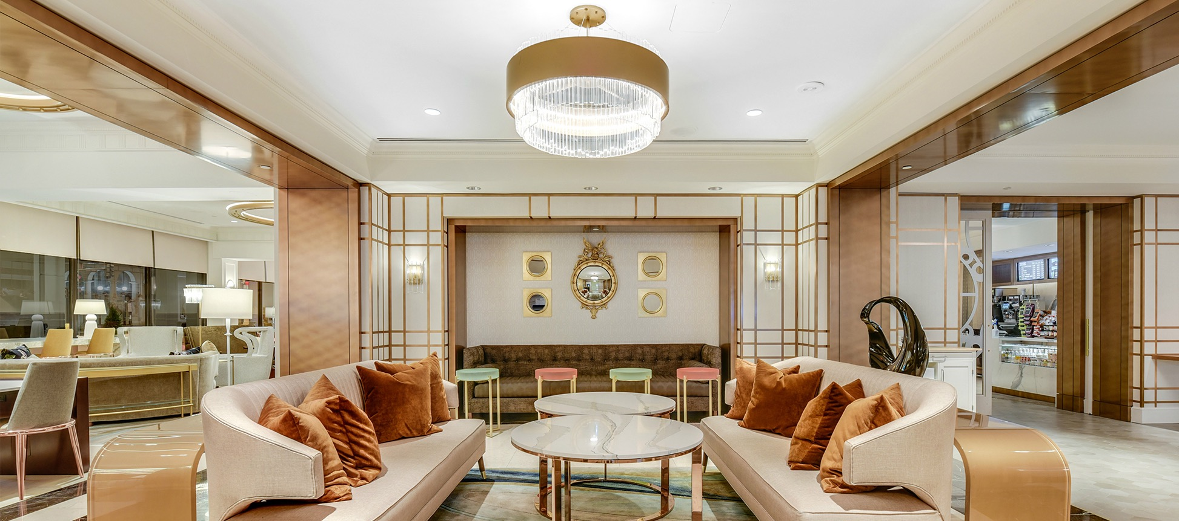
Introduction
Chemetal by Product Series
Chemetal by Popular Materials
Sustainability
Brand Overiew 2022-23
1-3
4-13
14-17
18
19-20
21
22
Treefrog Veneer
InteriorArts
Links
chemetal.com

Slide 2
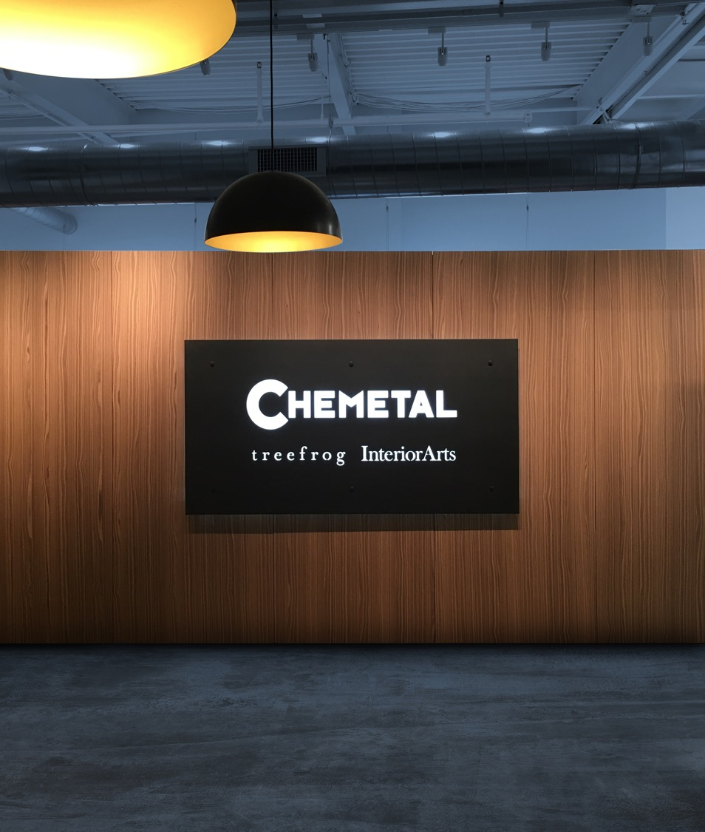
Chemetal is a massive collection
of metal designs & laminates
for interior spaces.
Let’s crank some metal. Chemetal is a second-generation family-owned company that’s been in business for 50+ years.
Many Chemetal designs are produced in-house at the company’s 70,000 sq. ft. facility in Western Massachusetts. Others are sourced from the best suppliers the world over.
It’s all sold through an international, though mostly domestic, distributor network and backed up by a sales and customer service team that cares about getting it right.
Learn more
2

Slide 3
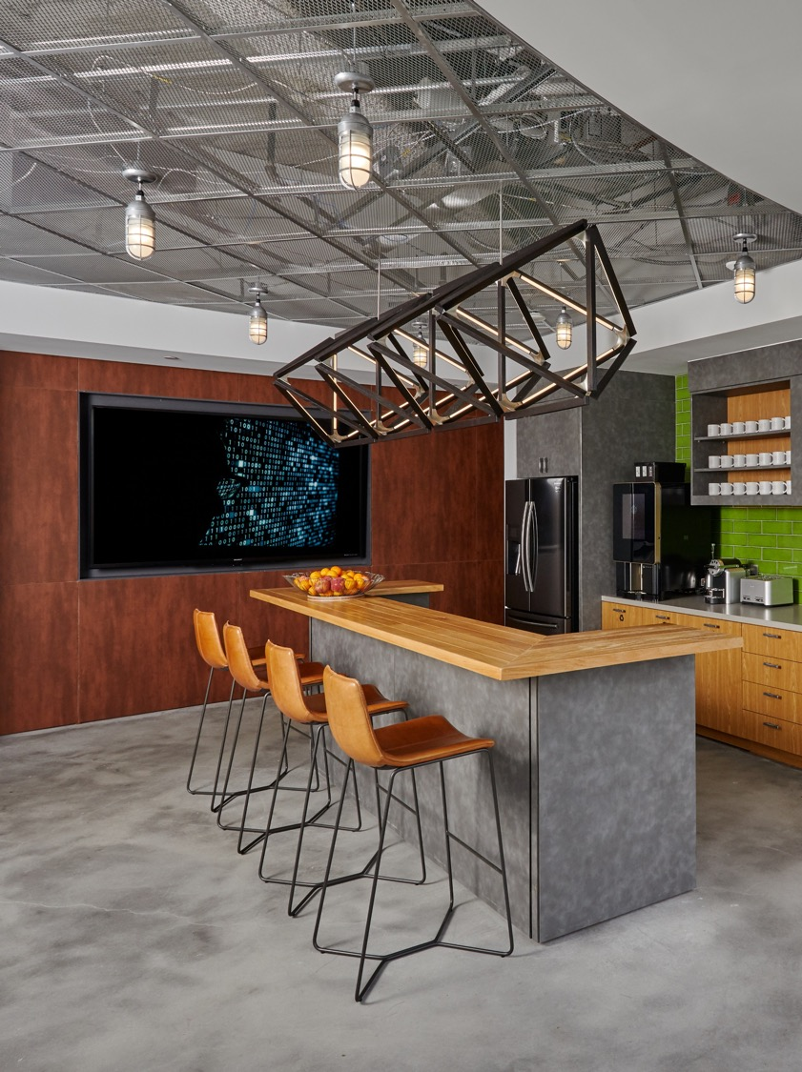
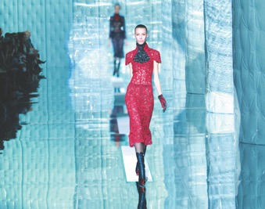
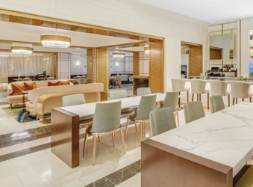
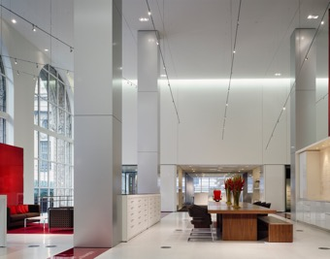
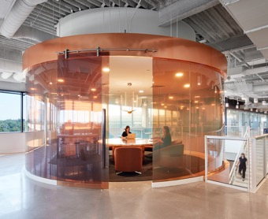
The best in metal design.
Chemetal is a contemporary and straightforward way to specify luxurious metal finishes for interior design projects.
The company has one of the largest selections of metal designs and laminates, with Chemetal designs installed worldwide in a variety of applications and commercial projects including:
Hospitality
Retail
Corporate
Signage
Furniture
Restaurants
Entertainment
Residential
Learn more
3

Slide 4
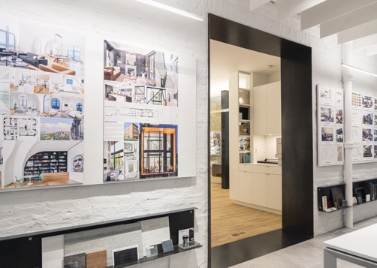
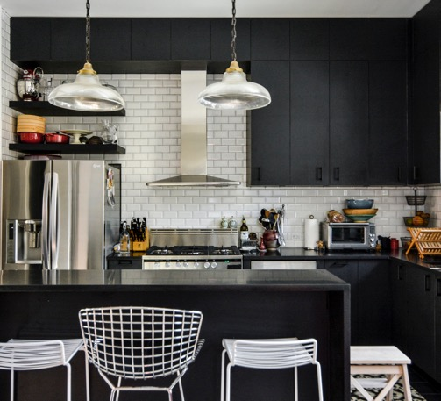
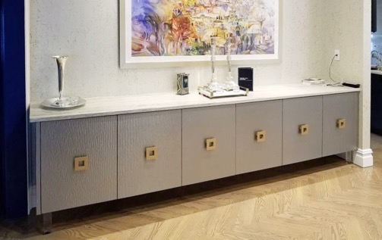
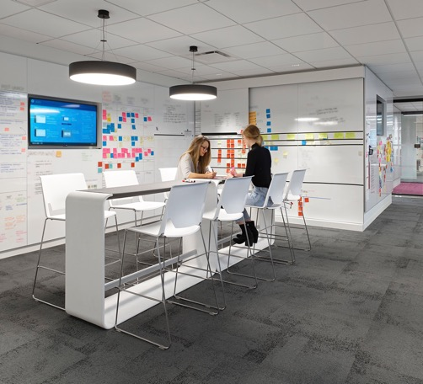
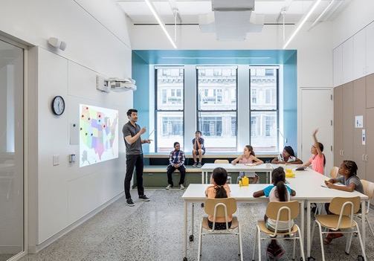
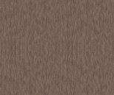


Magnetic Laminates
#150
Series
#150 Series Magnetic Dry Erase Laminates are a great way to do dry erase.
Made with a thin layer of iron foil sandwiched in the HPL backer, to create magnetism.
Excellent durability and whiteness, ideal for daily dry erase communications.
#152 is especially popular. #160 is solid steel with dry erase coating (made in USA).
Magnetic, Dry Erase, Chalk and custom (Magnetic backer that can be covered).
High pressure laminate backer.
European quality, made in Germany.
4’ x 8’, 4’ x10’ (#152 only) size.
See them all
#150
#151
#152
#160
4

Slide 5
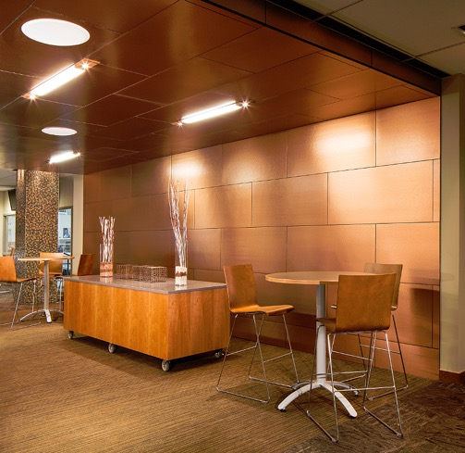
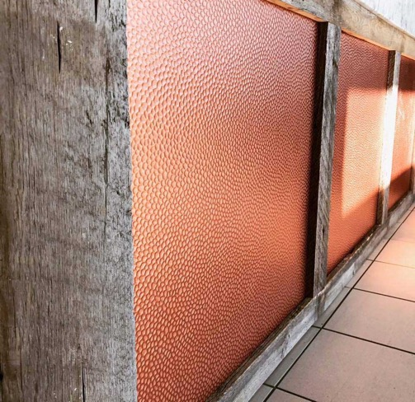
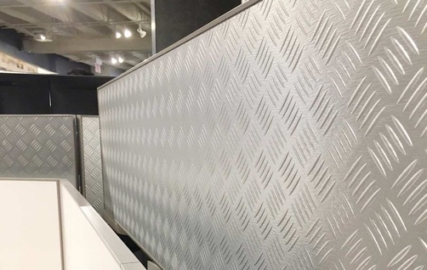
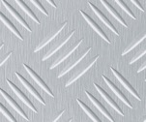
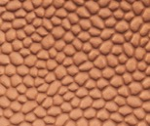
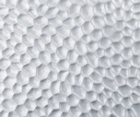
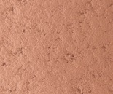

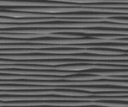
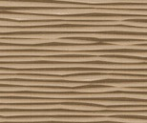
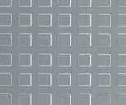

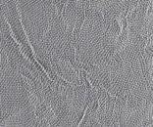
HPL Metal Laminates
#200
Series
Embossed and textured HPL Design Laminates.
Made by pressing a layer of metal onto an easy-to-work-with laminate backer.
Manufactured in Germany under European quality, workplace and environmental standards.
Durable, beautiful, and easy to apply.
High pressure laminate (HPL) backer.
4’ x 8’ sheet size.
See them all
#216
#218
#221
#230
#227
#232
#236
#253
#262
#275
5

Slide 6
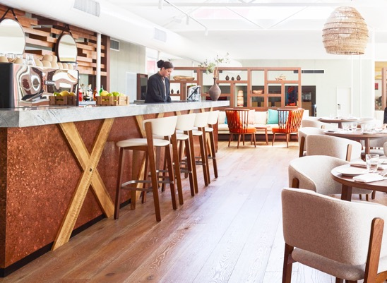
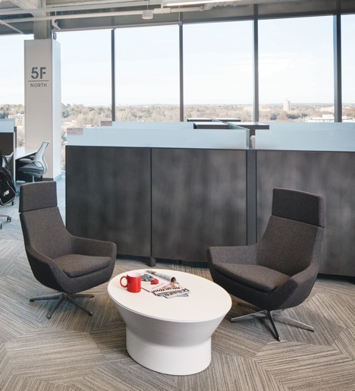
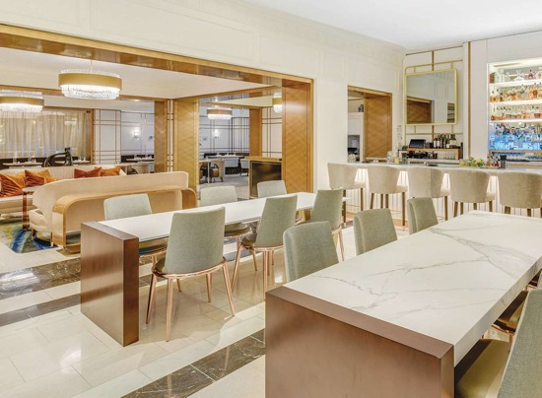
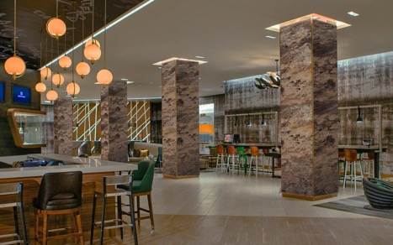

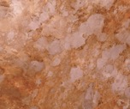
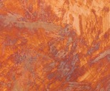



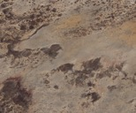



Handcrafted Metals
#300
Series
Handcrafted Metal Designs are one-of-a-kind materials produced with manufacturing consistency.
HPL and solid metal designs on aluminum,
brass and copper.
Made by Chemetal, among company’s most popular designs.
Available in aged brass, darkened aluminum
and deeply oxidized copper patinas.
Brass designs available in 2’ widths.
4’ x 8’, 4’ x 10’ sheet size
See them all
#310
#315
#317
#325
#337
#338
#340
#352
#353
#354
6

Slide 7
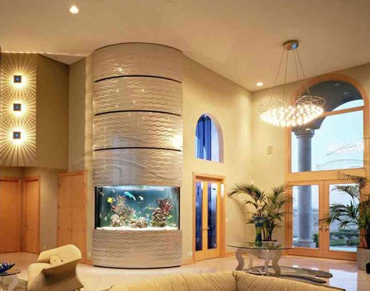
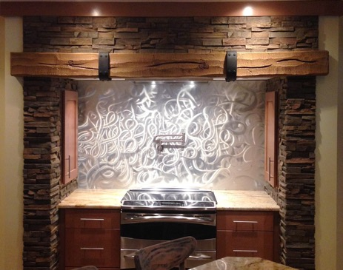
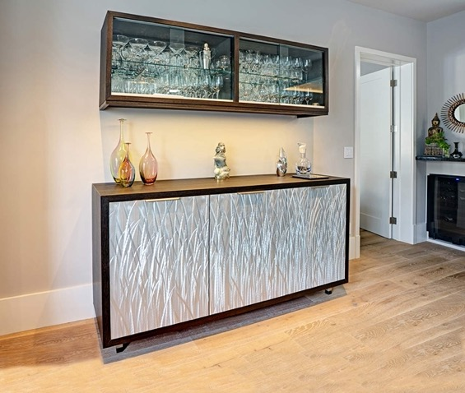
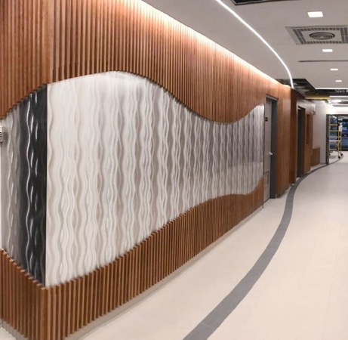
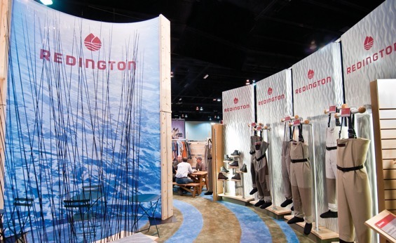
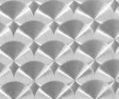



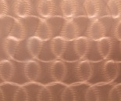

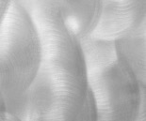

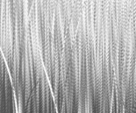

Deeply Brushed Metals
#400 #500
Deep brushing brings out energy and depth found only in metal. Directional and non-directional patterning that bends and plays with light.
Hand and machine brushed for a textured, patterned design.
Long-time Chemetal designs on aluminum.
Solid, thin aluminum.
Low pressure backer can be added.
4’ x 8’, 4’ x 10’ sheet sizes.
See them all
#406
#413
#414
#420
#423
#427
#440
#501
#504
#505
7

Slide 8
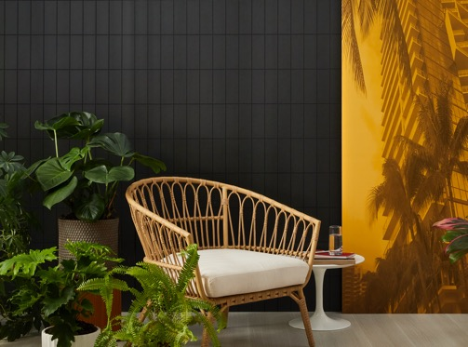
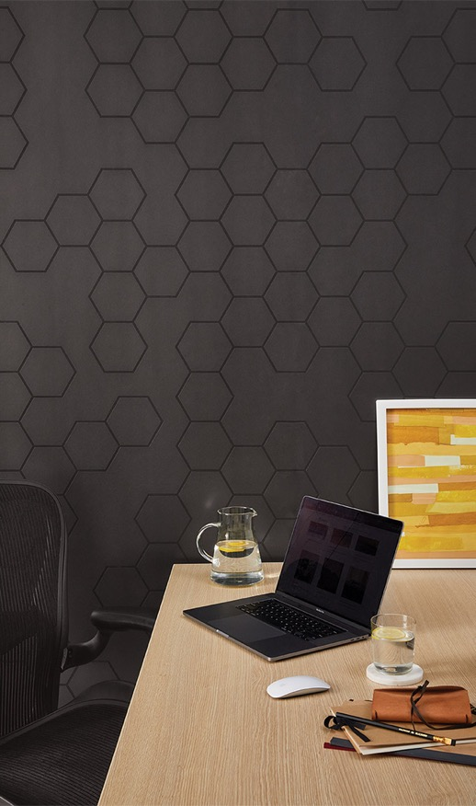
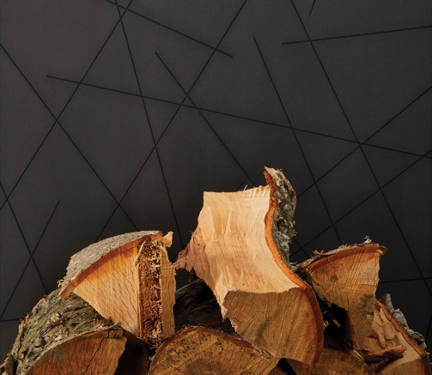

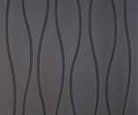
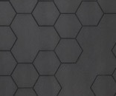
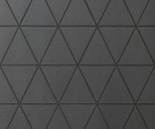

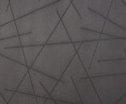
Surface Mode
#550 Series
Introducing Surface Mode, new CNC designs on thicker aluminum panels.
CNC carved design panels.
6 standard designs, customization available.
Popular ALU finish (#354) on .090” aluminum.
Powder coat finishing available.
No need for panel or MDF, metal can be applied directly to wall frame with screws/hardware.
4’ x 8’ sheet size plus custom cuts.
See them all
#550
#551
#552
#553
#554
#555
8

Slide 9
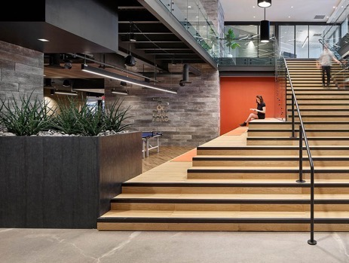
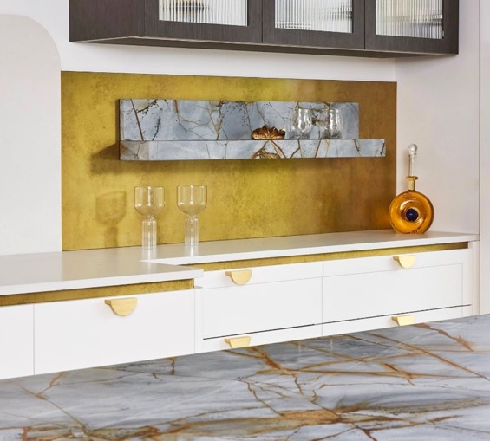
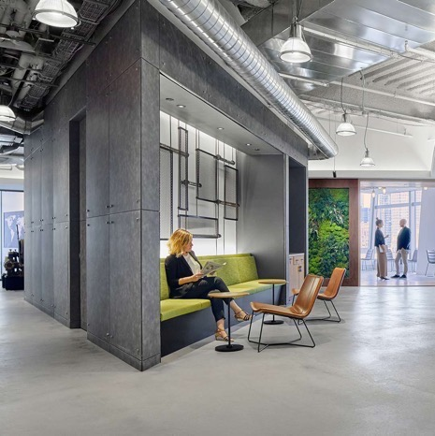












Architectural Metals
#600 Series
Rich, dynamic and dimensional designs representing historical metals.
Aged metal designs.
Exceptional quality, made in Japan.
Printed on aluminum for consistency and durability.
Some designs suitable for exterior use
(requires exterior backer).
4’ x 8’ sheet size.
See them all
#600
#601
#606
#607
#608
#609
#610
#613
#614
#620
9

Slide 10














HPL Classics
#700 Series
Part of Chemetal’s Classic Metals, HPL Classics are popular and functional metal laminates.
Thin metal surface means lightweight materials, making installation easier for those familiar with laminate fabrication.
High pressure laminate (HPL) backer.
European quality, made in Germany.
Aluminum, copper, brass, bronze, stainless.
4’ x 8’, 4’ x 10’ sheet sizes.
See them all
#701
#702
#703
#704
#706
#712
#717
#719
#721
#724
10

Slide 11










Traditional Classics
#800 Series
Part of Chemetal’s Classic Metals, Traditional
Classics are exceptionally rich metals with
luxurious visual depth and durability.
Chrome-plated brass along with solid
brass designs.
Added low pressure laminate backer option.
2-foot width, standard lengths (8’ and 10’).
See them all
#801
#802
#803
#804
#812
#814
11

Slide 12













Anodized Classics
#900 Series
Part of Chemetal’s Classic Metals, Anodized Classics create the look of any metal in durable, affordable and easy to fabricate aluminum.
Huge selection of 24 designs.
Anodizing process creates protective coating and allows color to be added to metal surfaces.
Polished, satin, brushed options.
Made in USA.
Added low pressure laminate backer option.
4’ x 8’, 4’ x 10’, and custom sheet sizes.
See them all
#901
#902
#903
#904
#906
#908
#909
#910
#911
#912
12

Slide 13














Large Format
Large Format
Large format designs are made in-house using embossing, brushing and other techniques. These dynamic designs are too big for our sample chains. Many custom options are possible with these Chemetal-produced designs.
See them all
Tints
Tints are made on #400 and #500 Series deeply brushed aluminum designs. Standard and custom colors are added to the topcoat.
See them all
Factory
Triangles
Domes
Food Truck
Majestic
Waterworld
Chartreuse
Cider
Real Red
Sky Blue
13

Slide 14





New Designs
Launching in 2023! New materials and new capabilities.
Chemetal recently expanded its metal cutting capabilities with the purchase of a large bed fiber laser.
The laser allows us to cut standard and custom patterns out of aluminum up to .25” thick, as well as etch designs on the surface.
These capabilities are ideal for privacy screens, panels, room dividers and more. Along with laser cut panels, Chemetal is also introducing a color collection of powder-coated metal designs.
Learn More
14

Slide 15





Classic Metals
An impressive collection of beautiful, classic metal
designs in Chemetal’s 700, 800 & 900 Series.
Classic Metals emulate the look of more expensive metals while being easier to fabricate with woodworking equipment.
Ideal for inlays, cut-to-size, strips, panels, and anywhere design professionals want the modern, luxurious and energetic look of real metal.
Available as HPL with a laminate backer for install ease (700 Series), or as solid anodized aluminum ideal for bending and clean edges (900 Series).
Brass, bronze, copper stainless, brushed satin and polished metal looks.
See them all
15

Slide 16






Meet the top brass.
Chemetal has a wide range of brass and brass looks
throughout its massive collection.
#300 Series designs are popular aged and antiqued real brass designs created in-house.
#700 Series HPLs and #900 Series anodized aluminums, though not as rich as real brass, are convincing, durable, light in weight, affordable and available in 4’ widths.
#800 Series solid brass designs are exceptionally rich and offer luxurious visual depth as well as durability.
#600 Series designs offer several brass looks as well.
See them all
16

Slide 17





Darkened Metals
The industrial look of darkened metals with consistency
in appearance and durability.
Darkened Metals that mimic blackened steel are popular materials from Chemetal, available in a range of metal designs.
#300 Series ALU Designs (#352, #353, #354) are hand darkened aluminum sheets made in-house and available in standard (.025”) and .090” thick sheets.
#600 Series Architectural offer a range of printed dark aluminum designs with depth and subtle variation.
#700 and #900 Series offer beautiful satin and brushed black metal designs in HPL and anodized aluminum.
See them all
17

Slide 18




Sustainability
Chemetal is dedicated to providing designers with product
transparency and sustainable materials.
Most Chemetal designs are made from aluminum, one of the most easily recycled materials on the planet.
Chemetal qualifies for LEED points
Part of Mindful Materials, product certification library.
HPDs (Health Product Declarations) exist for many Chemetal designs.
Chemetal powers its facilities with nearly 1000 rooftop solar panels.
Learn More
18

Slide 19






Treefrog is a prefinished wood
veneer laminate ideal for vertical
use in interior spaces.
Sublime European design aesthetic.
Standard sheets sizes.
Consistent veneer selection, sheet after sheet.
Popular walnut and oak veneer choices.
Flat and textured groove surfaces.
Made in Italy, Treefrog is stocked in USA.
Treefrog uses faster growing, more commonly occurring tree species, from documented and well managed forests, to create the look of more exotic woods.
Learn more
19

Slide 20















Reliable & consistent
so you can be wild & creative.
Treefrog’s unique manufacturing process ensures consistency, sheet after sheet, in design spaces of any size, making it ideal for larger projects, and multi-location installs where consistency is important.
Beginning in 2023, Treefrog will begin a switch from laminate to wood-based backers. The new backer is more flexible, better for the environment and better matches veneer color by eliminating dark edges.
25+ prefinished real wood veneer laminates.
4’ x 8’, 4’ x 10’ sheet sizes.
Available edge-banding options.
See them all
#60204
#60213
#64717
#60404
#60405
#60420
#60804
#62016
#62217
#62316
20

Slide 21






Step into a great laminate.
InteriorArts is a curated collection of unique designer HPL laminates for use in interior spaces.
Sophisticated neutral color palette.
Impressive textures and European design aesthetic.
Trending looks include light wood, metal and refined industrial surfaces.
Stocked in USA.
4’ x 8’, 4’ x 10’ sizes.
See them all
21

Slide 22







Links
Tech Data
Social
Click on the buttons below for resources for all three brands.
Technical information, certifications, literature and downloadable resources for distributors, reps and designers for Chemetal, Treefrog and InteriorArts
Follow us on social media.
Scroll through our often-updated feed of project photos, tradeshows, and the latest from all three brands
Follow us on Instagram.
Contact us.
For sales, samples, and customer service reach out to us Monday
through Friday, 8 am – 5 pm.
800 807-7341
samples@chemetal.com
sales@chemetal.com
chemetal.com
treefrogveneer.com
ialaminates.com
Email Alerts
Let’s stay in touch (in a professional way.)
Sign up for our weekly email alerts. It’s an easy way to stay up to date with what’s going on at Chemetal, Treefrog and InteriorArts.
Click here and enter your email to sign up.
21
22

